Slide 1
“Style and Tone in Writing”
Department of Computer Science

Slide 2
1- Style
The style of writing is affected by:
the variety of sentence constructions
the degree of formality used
The way a text is organized

Slide 3
A-Variety
Style can be improved by using a variety of sentence constructions. This makes the writing more interesting to read.
The main topic of the sentence should appear at the beginning of the sentence to show that it is important.
The examples on the next slides show three ways of writing the same piece of information.

Slide 4
Examples:
Because of the strike on the railways, deliveries were unfortunately delayed by one week. (Here, the most important information is that the strike on the railways is the cause of a problem.)
Deliveries were delayed by one week unfortunately because of the strike on the railways. (Here, the most important information is the problem that the deliveries were delayed.)
Unfortunately, because of the strike on the railways, deliveries were delayed by one week. (Here, the most important information is the fact that something unfortunate occurred.)

Slide 5
B-Formality
Written English is more formal than spoken language, especially in business emails and reports. The following points are important:
contractions (we’ll, you’ve, it’s, etc.) are not normally used in business correspondence
business emails and reports are more impersonal than emails to friends. ‘We’ is often used instead of ‘I’ when the writer represents the company.
the passive is often used as the reader is more interested in the action itself rather than who carried out the action

Slide 6
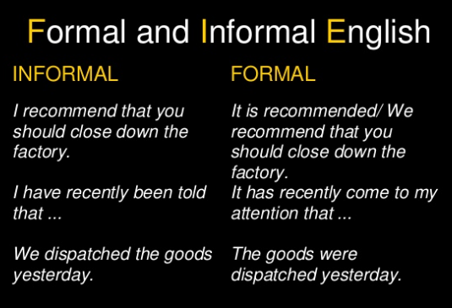

Slide 7
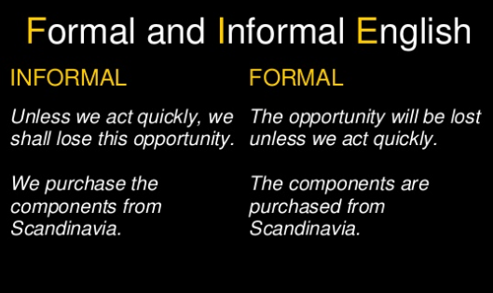

Slide 8
On the following slides are some common words and phrases. Some are normally spoken, or are used for an informal writing style. An alternative word or phrase that might be used in a formal email or report is shown in the next column.

Slide 9
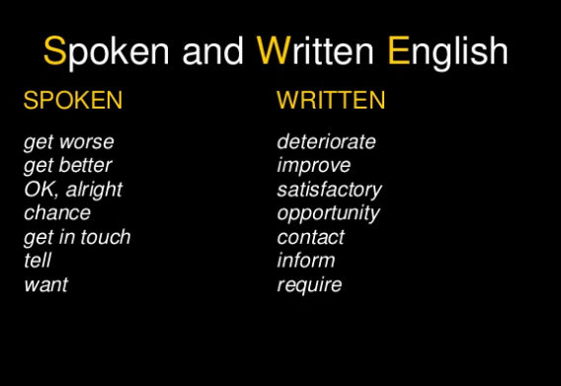

Slide 10
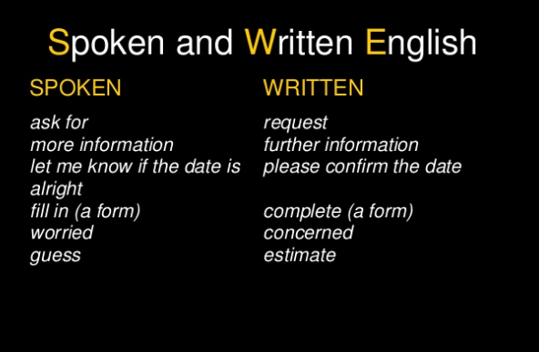

Slide 11
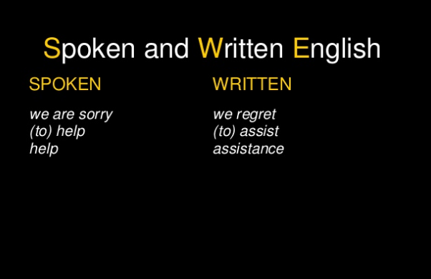

Slide 12
Spoken and Written English
Words and phrases in both columns may be used in spoken or written English, with the exception of ‘OK’, which is not used in business writing.
In general, the words and phrases in the ‘written’ column are used when writing to someone outside your own company.
It is also important not to use idiomatic language in formal letters and reports.

Slide 13
C- Organization
Cause - Effect
Problem – Solution
Chronological (sequencing the order of events)
Compare/Contrast
Inductive (specific to general)
Deductive (general to specific)
Division into categories
Ranking

Slide 14
2-Tone
The tone with which you express yourself in writing can be:
Strong
Neutral
Tentative
For example, you may want to express your view very strongly when making a recommendation in an email or report.

Slide 15
A-Strong
We strongly recommend that you carry out a thorough review of your information systems.
We are firmly convinced that the safety measures are inadequate.

Slide 16
B-Neutral
You can use a neutral tone to suggest to the reader that your view or recommendation is worth considering, but is not a strong one.
For example:
We recommend that you carry out a thorough review of your information systems.
We believe that the safety measures are inadequate.

Slide 17
C-Tentative
A tentative tone allows the reader to choose whether to act upon the view or to ignore it.
For example:
You might like to consider carrying out a thorough review of your information systems.
It would seem that the safety measures are inadequate.

